Slide 1
Welcome to The Hilton Lane Family
EYFS Meeting – 19th June 2023

Slide 2
At Hilton Lane Primary School, our vision is for every child to feel happy and safe with a strong sense of belonging - they will look back on their time with us and smile. Our children have things to say and places to go, they know what they will always be listened to and what they say will be valued. The Hilton Lane Family value what each and every child has to offer. Together as a team, we support and challenge our children to help them to become resilient individuals who have the highest expectations of themselves in all aspects of their work and life. We want our children to exceed their potential and aspire to their goals, knowing that we are right behind them as their champions.
“
”
The Hilton Lane Vision

Slide 3
Core Values
C
Our Six Core Values
Resilience
Kindness/ Empathy
Respect
Aspirational/ Pride
Generosity
Responsibility

Slide 4
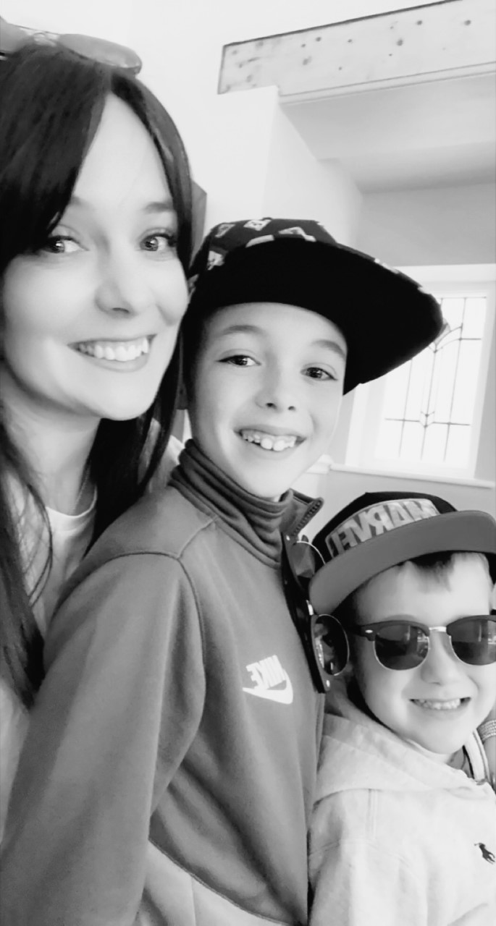
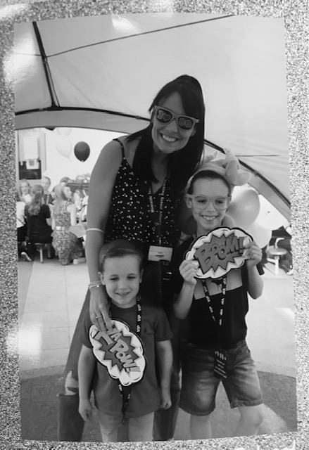
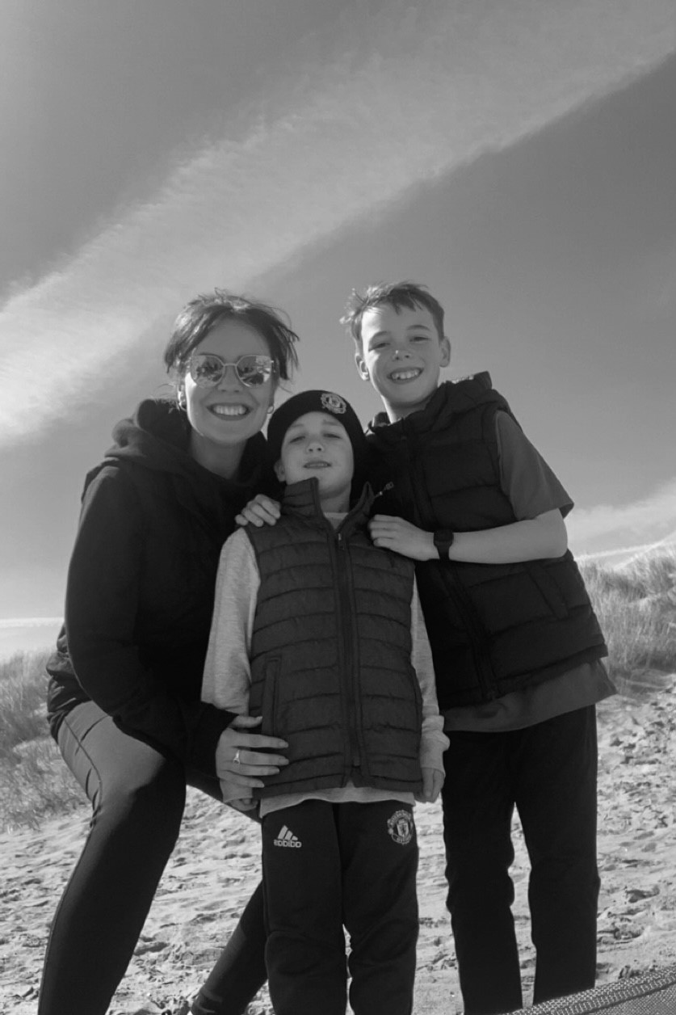
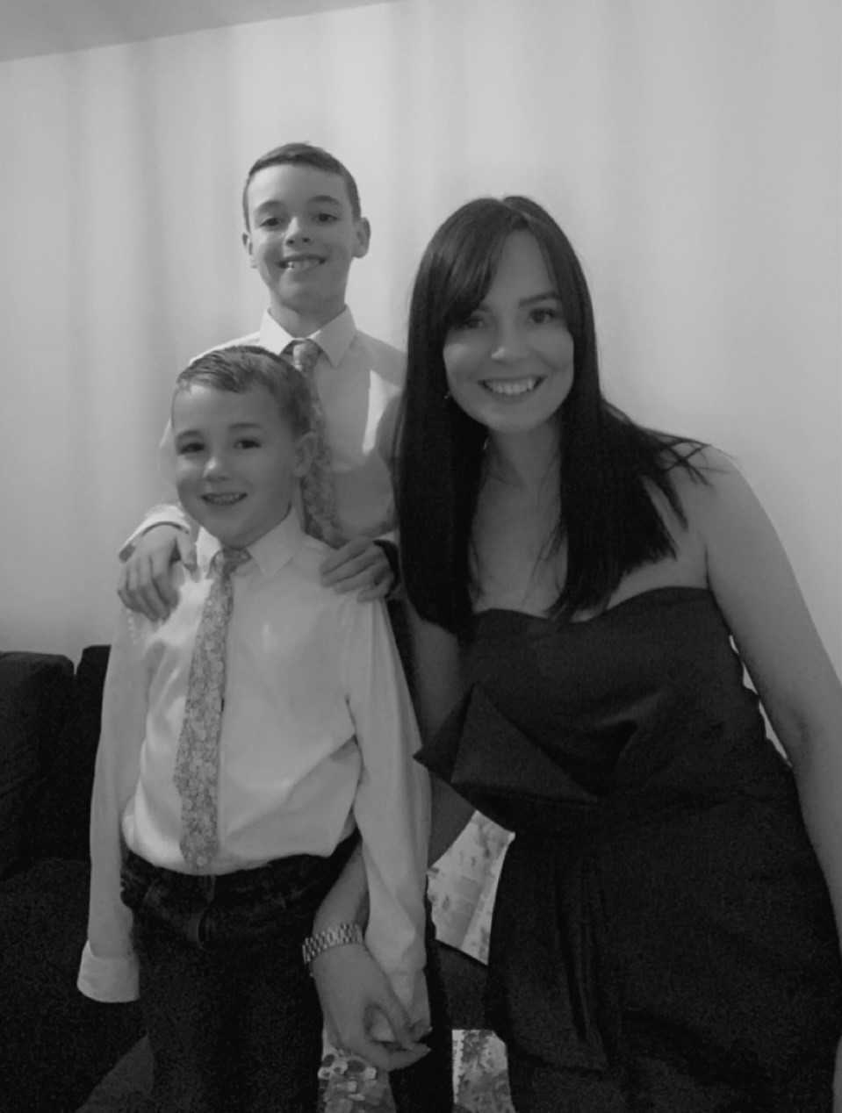
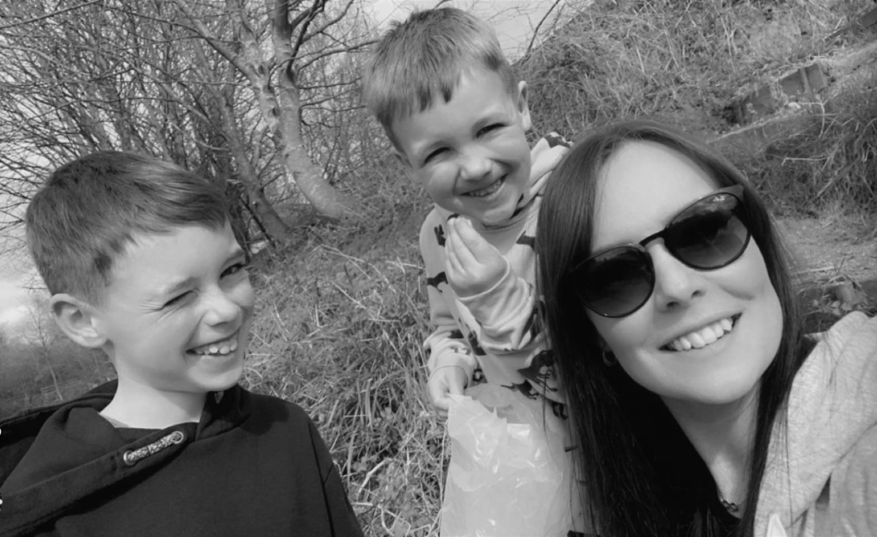
Miss Kearsley’s Boys
Max
Alex

Slide 5
Tag line…
‘If it’s not good enough for Max and Alex, then it isn’t good enough for the children at Hilton Lane.’

Slide 6
Welcome to The Hilton Lane Family! Whether your child is about to start at Hilton Lane, or are continuing their journey on into our Reception Class, we are looking forward to a happy and successful year. This meeting will provide you with all the information you will need before your child starts in their new class.
You will also have an opportunity to look at our Reception classroom after the meeting.

Slide 7
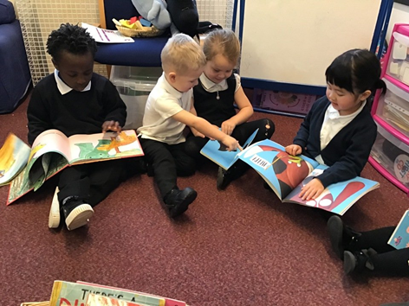
The EYFS at Hilton Lane
Our Early Year at Hilton Lane is unique:
Hilton Lane Nursery is on a separate to the main school on Prescott Street.
The reception class is at the main school
We do work together as a team and have some special events together such as sports day and a Christmas show.

Slide 8
The EYFS staff
EYFS lead: Mrs Splaine
Nursery teacher: Mrs Splaine
Reception teacher: Miss Pilling
Nursery teaching assistant: Miss Newsom
Reception teaching assistant: Miss Wall (tbc)

Slide 9
What is it like to be a child in our early years classrooms?
Learning in the EYFS is lots of fun for your child.
Learning is based around play based activities and a carefully planned environment which will support your child’s learning and development.
Children will have access to both indoor and outdoor play.
Both the indoor and outdoor areas are arranged so that your child has a rich range of experiences to develop their learning.
Children’s experiences are planned around seven areas of learning.
During the day in our EYFS classrooms, there will be a variety of different types of activities and learning experiences. Children will spend time working and playing with the adults in the classroom and will have time playing more independently.

Slide 10
Early Years Foundation Stage

Slide 11
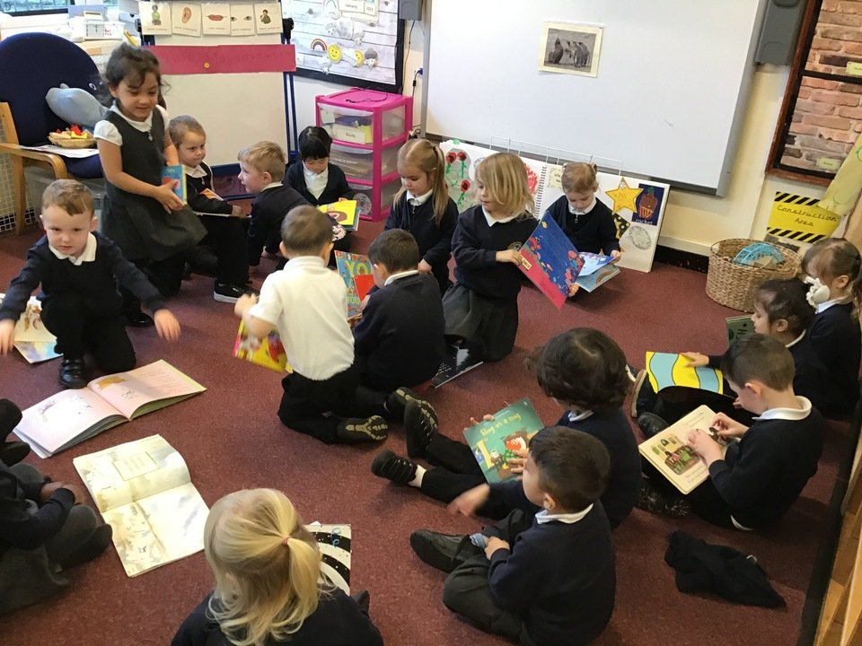
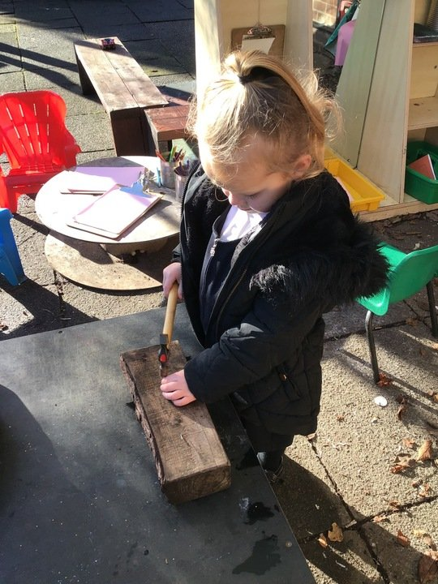
Our EYFS curriculum
The Early Years Curriculum is based on 7 Areas of learning.
Prime Areas
Communication, Language and Understanding
Physical Development
Personal, Social and Emotional Development
Specific Areas
Literacy Development
Maths Development
Understanding of the World
Expressive Arts and Design
These areas of learning will all be taught through focused whole class and small group sessions and through play based activities.

Slide 12
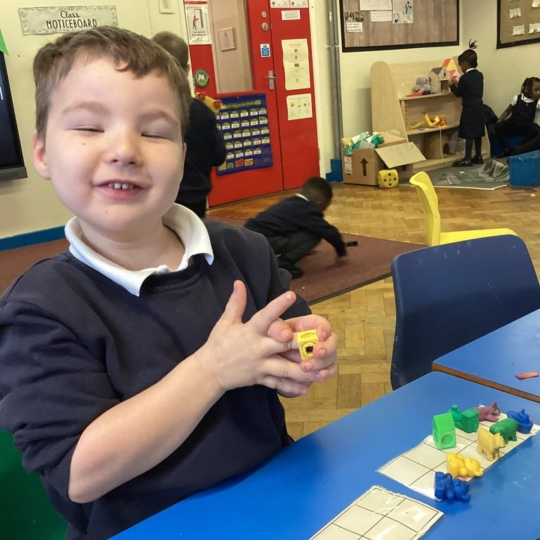
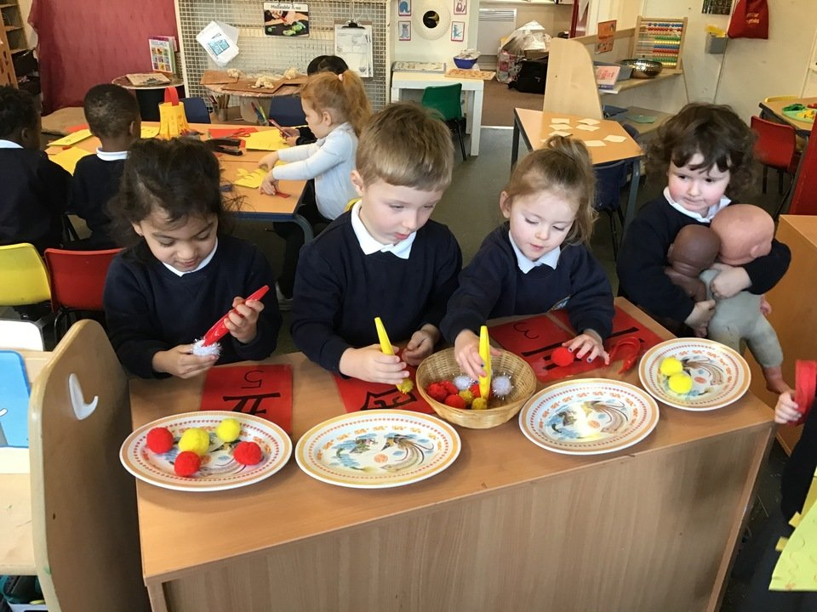
The Characteristics of Effective Learning
The characteristics of effective learning refers to the way your child learns…

Slide 13
Practical things that you will need to know...

Slide 14
Settling in - NURSERY
You and your child will be invited to a stay and play session on either 29th or 30th June (am). Details will be posted on Seesaw.
The school year start on Tuesday 5th September
NURSERY
Setting in
Home visits – 5th and 6th September.
From 7th/8th September children will start part-time and we aim for your child to be full time (if they are ready) by 15th September.
Full time day
9.15am (children can arrive from 9.05am) – 3.15pm
GOOD ATTENDANCE AND PUNCTUALITYARE VERY IMPORTANT

Slide 15
Settling in - RECEPTION
Your child will be spending time in their new class on Thursday 29th June and Friday 30th June (am). Details will be posted on Seesaw.
The school year start on Tuesday 5th September
RECEPTION
Setting in
Children who have been to our nursery will be full time from 5th September
Children who are new to our school will start on 6th September with a couple of day settling in. The aim for your child to be full time by 8th September
Full time day
9.00am (children can arrive from 8.45am) – 3.30pm
GOOD ATTENDANCE AND PUNCTUALITY ARE VERY IMPORTANT

Slide 16
What uniform will I need to buy?
We wear a uniform at Hilton Lane
Black skirts or pinafore.
Black elasticated trousers
Navy blue sweatshirts or cardigans.
White polo shirt.
Black school shoes/plain black trainers (if you opt for trainers they MUST be fully black, any colour will be swapped for school spare pumps)
Children may wish to wear a blue and white gingham dress or black shorts in the summer.
PLEASE PUT NAMES IN ALL CLOTHING/SHOES
PE in Reception In reception, your child will do PE - please send a PE kit into school in a bag. Please see additional information on the website for information about PE kits and ensure all items are labelled with your child’s name.

Slide 17
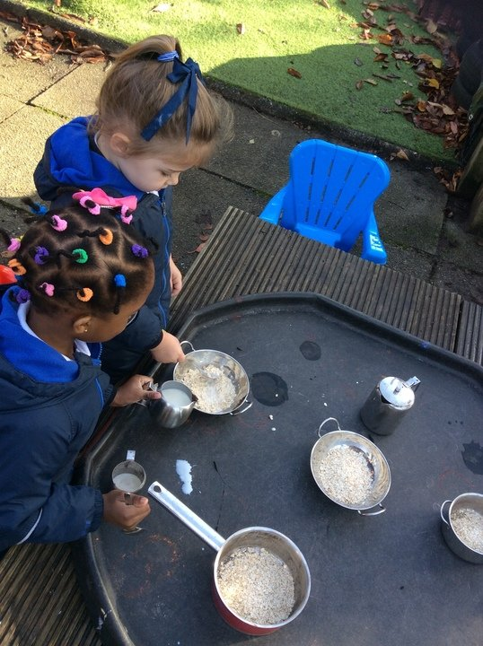
Do I need to provide any clothing for outdoor play?
Play in the EYFS is fun and can also be very messy!
You may provide wellies for use during outdoor play if you wish.
We have waterproofs available for when children are playing in the mud kitchen or water.
We also ask that you provide spare clothing for your child to keep on their peg in case they have a toileting accident, get wet in the water or get a little too muddy in the mud kitchen.
This should include a spare t-shirt, trousers, shoes, socks and underwear.
Please put your child’s name all of their uniform and spare clothes including their shoes.

Slide 18
What can my child have at dinnertime?
Your child can have a school dinner or bring a packed lunch.
If your child is in reception class they will receive a free school dinner.
For children in the nursery, school dinners are currently £2.10 a day.
If you are eligible for free school meals, you will need to register this before starting at the nursery. The office staff will help you with this today or you can telephone 0161 793 2500
If you choose to provide a packed lunch for your child, please look at our packed lunch policy which is available on the school website.
Milk and fruit is available to all children every day.
PLEASE SEND IN A WATER BOTTLE EVERY DAY

Slide 19
What if my child has a medical condition?
If your child has any medical conditions, allergies or dietary requirements, we need to know this before they start. Please include on the new starter forms clearly.
If your child has a prescribed medicine at any point throughout the school year you will be required to fill in a form before your child can be given the medicine. Medicines can only be given at school if prescribed by a doctor and needed four times a day.
If your child has asthma they must have a spare inhaler in school. This should be brought into school on their first day. It must have the prescription label on showing their name.

Slide 20
How will I stay connected during my child’s time in school?
Seesaw- This is an app available on your phone where we can send you pictures, letters and messages to keep you updated. This is our main way of communicating information to you, so please check it regularly.
Telephone – we may telephone you with a message. Please ensure your contact details are kept up-to-date at all times.
Curriculum overviews – We will post these on the website and Seesaw to let you know what your child will be learning throughout the half term.
School website – school holiday and lots of other information.

Slide 21
How can parents help in school?
COMPLETE THE NEW STARTER FORM (and return on or before 30th June 23)*
COMPLETE THE ALL ABOUT ME FORM (and return on or before 30th June 23)*
Let the office know if your child is not going to be in.
Keep your contact details up to date.
Help with walking down to school (nursery).
Attend any meetings or special events.
*Or before you leave would be even better!

Slide 22
How can you help before your child starts in September?
Let us know about your child’s interests and about what your child can do at home by completing the ‘All about me form’.
Encourage your child to be independent. This will help them immensely when they are at school:
Putting on their own coat and shoes
Using the toilet independently.
Washing their hands on their own.
Using a knife and fork.
Talk and listen to your child and encourage them to talk and listen!

Slide 23
We hope you have found this information useful.
We are looking forward to welcoming you and your child in September!
If you have any questions you would like to ask, we will be available now to speak to you.
Mrs Lowe and Mrs Anderson will be here after the meeting to help with applications for free school meals and 15 hours funding.
If you have any further questions after this meeting, please do not hesitate to email or telephone:
hiltonlane.primaryschool@salford.gov.uk
0161 921 1195 (Main school)
0161 0161 703 8945 (Nursery)
Thank you!

